Slide 1
DESIGN AND FABRICATION OF A STEWART PLATFORM
BITS F441 ROBOTICS

Slide 2
Candidates
JULOORI AMOGH - 2020AAPS0422H
TANAY RANJAN - 2020A3PS0483H
THATHAPUDI SANJEEV PAUL - 2020AAPS0120H
BHAVYA JAIN - 2020A7PS0240H

Slide 3
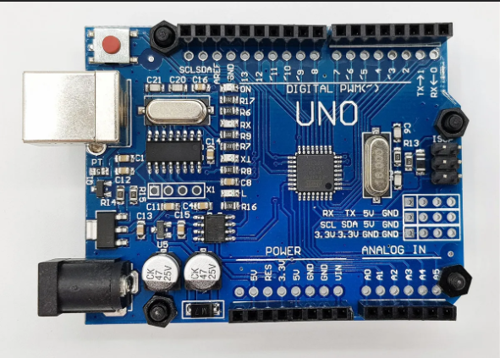

Components List
Arduino UNO with cable

Slide 4
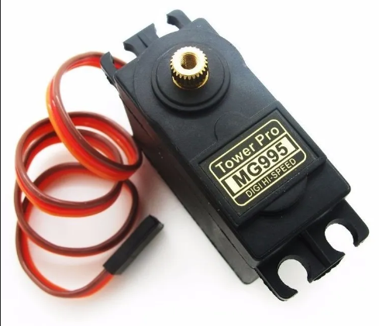
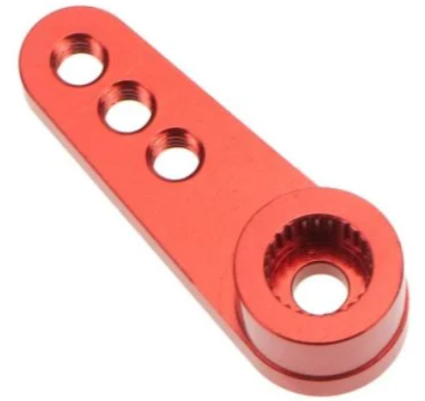
Components List
2. MG995 Servo x 6 3. Servo Horn x 6

Slide 5
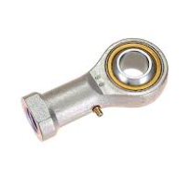
Components List
4. Rod End Bearing Spherical Joints - 6mm x 12

Slide 6
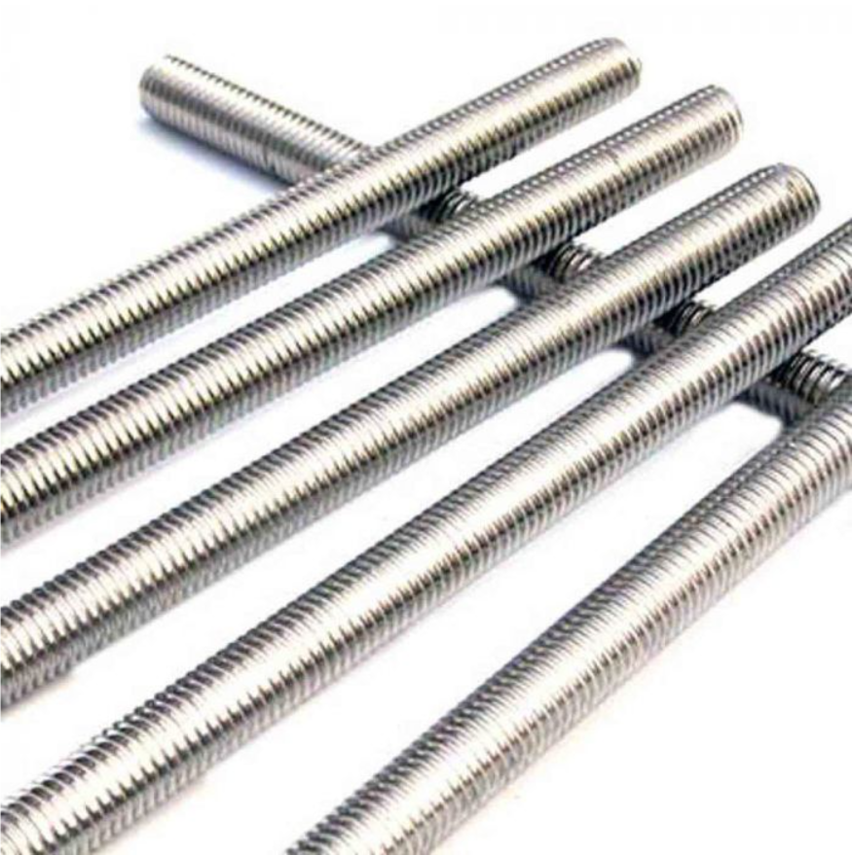
Components List
5. Metal shafts with threading - 6mm x 6

Slide 7
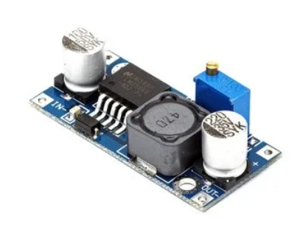
Components List
6. LM2596S DC-DC Buck Converter x 3

Slide 8
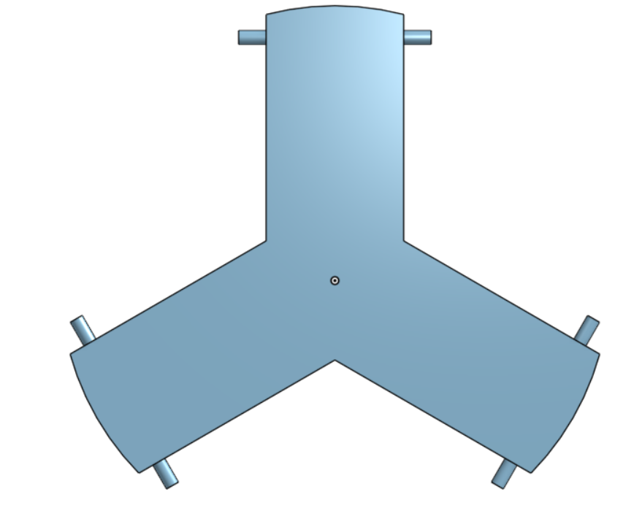
Components List
7. 3D Printed Platform

Slide 9

Components List
8. Wooden Base - 40x30 cm
9. Power Source AC-DC 12V-2A supply

Slide 10
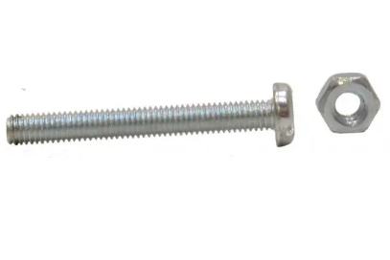
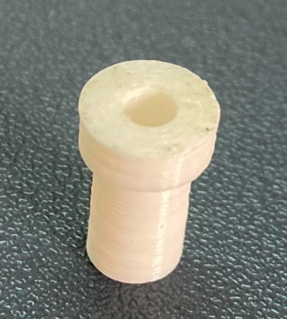
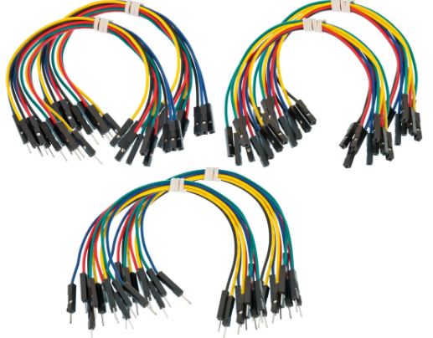
Components List
10. Screws and nuts- M3 with 3D
printed 6mm->3mm
connectors x 6
11. Jumper Wires

Slide 11
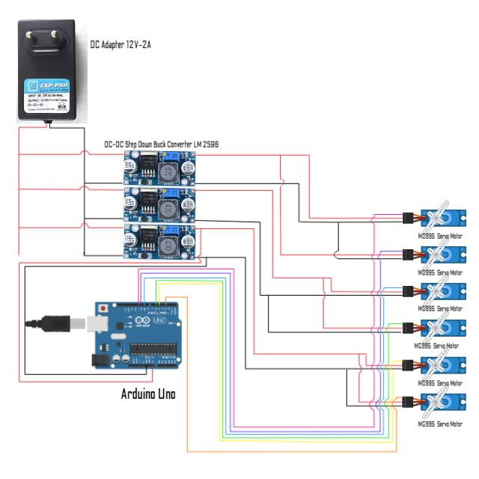
Circuit Diagram

Slide 12
Types of Motion
Using the Arduino IDE, we have been able to establish four
four different types of motion:
Vertical Motion
Twisting Motion
Circular Motion in a horizontal plane
Phase Difference or Sine wave motion

Slide 13
Vertical Motion
Code:
// To include the Servo library
#include <Servo.h>
Servo Servo1;
Servo Servo2;
Servo Servo3;
Servo Servo4;
Servo Servo5;
Servo Servo6;
// Servo Pin numbers
int servoPin1 = 5;
int servoPin2 = 6;
int servoPin3 = 9;
int servoPin4 = 11;
int servoPin5 = 10;
int servoPin6 = 3;
void setup() {
// Servo pins setup
Servo1.attach(servoPin1);
Servo2.attach(servoPin2);
Servo3.attach(servoPin3);
Servo4.attach(servoPin4);
Servo5.attach(servoPin5);
Servo6.attach(servoPin6);
}
void loop() {
//To move the platform vertically up and down
int i = 0;
int j = 0;
while(i <= 90) {
j =180 - i;
Servo1.write(i);
Servo2.write(j);
Servo3.write(i);
Servo4.write(j);
Servo5.write(i);
Servo6.write(j);
delay(25);
i += 1;
}
// Servo1.write(45);
// Servo2.write(135);
// Servo3.write(45);
// Servo4.write(135);
// Servo5.write(45);
// Servo6.write(135);
while(i >= 0) {
j =180 - i;
Servo1.write(i);
Servo2.write(j);
Servo3.write(i);
Servo4.write(j);
Servo5.write(i);
Servo6.write(j);
delay(25);
i -= 1;
}
}

Slide 14
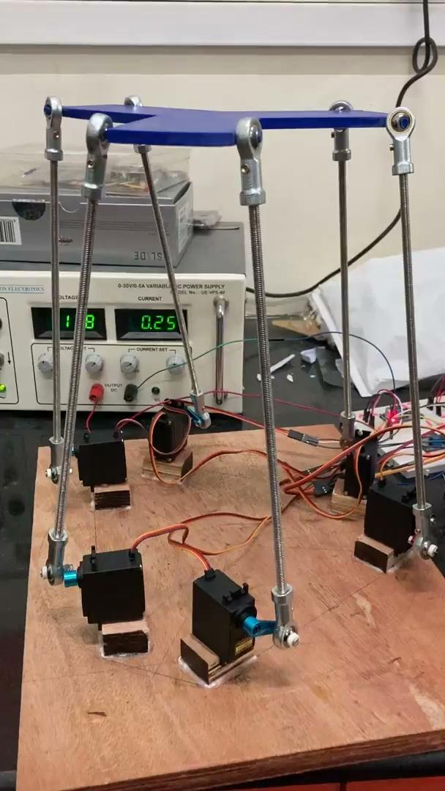
Vertical Motion
Video:

Slide 15
Twisting Motion:
Code:
#include <Servo.h>
Servo Servo1;
Servo Servo2;
Servo Servo3;
Servo Servo4;
Servo Servo5;
Servo Servo6;
int servoPin1 = 5;
int servoPin2 = 6;
int servoPin3 = 9;
int servoPin4 = 11;
int servoPin5 = 10;
int servoPin6 = 3;
void setup() {
// put your setup code here, to run once:
Servo1.attach(servoPin1);
Servo2.attach(servoPin2);
Servo3.attach(servoPin3);
Servo4.attach(servoPin4);
Servo5.attach(servoPin5);
Servo6.attach(servoPin6);
}
void loop() {
// put your main code here, to run repeatedly:
int i = 45;
int theta = 15;
while(i <= 45+theta) {
Servo1.write(i);
Servo2.write(90+i);
Servo3.write(i);
Servo4.write(90+i);
Servo5.write(i);
Servo6.write(90+i);
delay(75);
i++;
}
while(i >= 45-theta) {
Servo1.write(i);
Servo2.write(90+i);
Servo3.write(i);
Servo4.write(90+i);
Servo5.write(i);
Servo6.write(90+i);
delay(75);
i--;
}
while(i <= 45) {
Servo1.write(i);
Servo2.write(90+i);
Servo3.write(i);
Servo4.write(90+i);
Servo5.write(i);
Servo6.write(90+i);
delay(75);
i++;
}
}

Slide 16
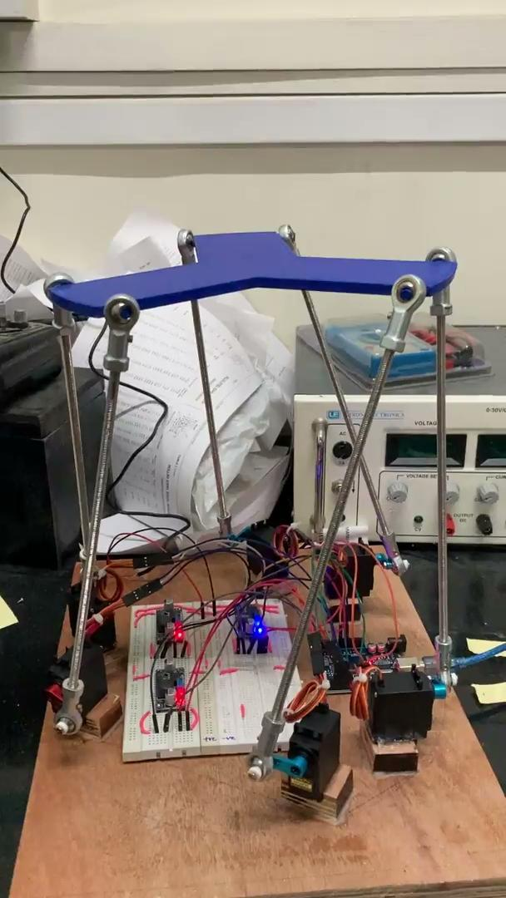
Twisting Motion:
Video:

Slide 17
Horizontal Circular Motion:
Code:
#include <Servo.h>
Servo Servo1;
Servo Servo2;
Servo Servo3;
Servo Servo4;
Servo Servo5;
Servo Servo6;
int servoPin1 = 5;
int servoPin2 = 6;
int servoPin3 = 9;
int servoPin4 = 11;
int servoPin5 = 10;
int servoPin6 = 3;
void setup() {
// put your setup code here, to run once:
Servo1.attach(servoPin1);
Servo2.attach(servoPin2);
Servo3.attach(servoPin3);
Servo4.attach(servoPin4);
Servo5.attach(servoPin5);
Servo6.attach(servoPin6);
}
void loop() {
int i = 45;
while(i <= 90) {
Servo1.write(90-i);
Servo2.write(90+i);
Servo3.write(45);
Servo4.write(135);
Servo5.write(i);
Servo6.write(180-i);
delay(75);
i++;
}
int counter = 0;
while(counter < 5) {
i = 0;
while(i <= 45) {
Servo1.write(i);
Servo2.write(180-i);
Servo3.write(45+i);
Servo4.write(135-i);
Servo5.write(90-2*i);
Servo6.write(90+2*i);
delay(75);
i++;
}
i = 0;
while(i <= 45) {
Servo5.write(i);
Servo6.write(180-i);
Servo1.write(45+i);
Servo2.write(135-i);
Servo3.write(90-2*i);
Servo4.write(90+2*i);
delay(75);
i++;
}
i = 0;
while(i <= 45) {
Servo3.write(i);
Servo4.write(180-i);
Servo5.write(45+i);
Servo6.write(135-i);
Servo1.write(90-2*i);
Servo2.write(90+2*i);
delay(75);
i++;
}
counter++;
}
i = 0;
while(i <= 45) {
Servo1.write(i);
Servo2.write(180-i);
Servo3.write(45);
Servo4.write(135);
Servo5.write(90-i);
Servo6.write(90+i);
delay(75);
i++;
}
}

Slide 18
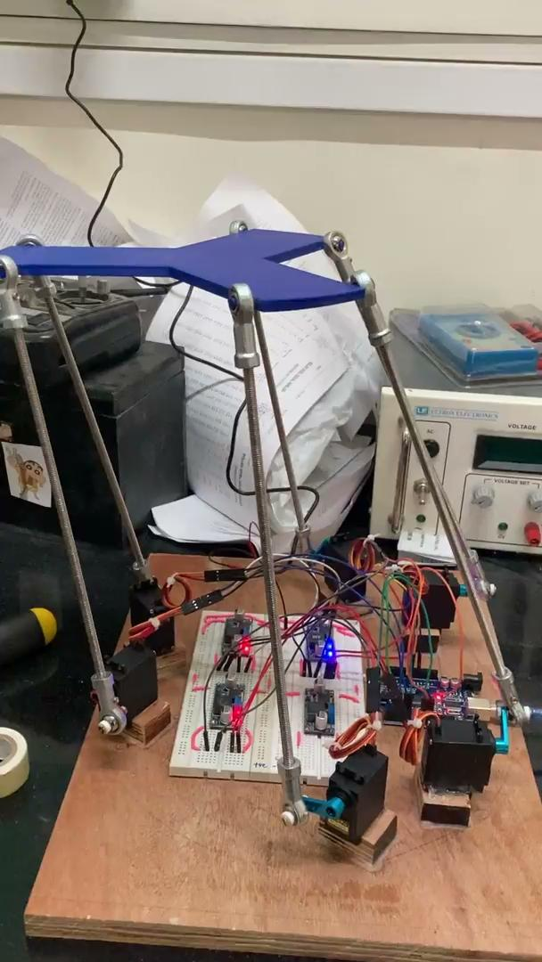
Horizontal Circular Motion:
Video:

Slide 19
Phase Difference Motion:
Code:
#include <Servo.h>
Servo Servo1;
Servo Servo2;
Servo Servo3;
Servo Servo4;
Servo Servo5;
Servo Servo6;
int servoPin1 = 5;
int servoPin2 = 6;
int servoPin3 = 9;
int servoPin4 = 11;
int servoPin5 = 10;
int servoPin6 = 3;
void setup() {
// put your setup code here, to run once:
Servo1.attach(servoPin1);
Servo2.attach(servoPin2);
Servo3.attach(servoPin3);
Servo4.attach(servoPin4);
Servo5.attach(servoPin5);
Servo6.attach(servoPin6);
}
void loop() {
int i = 45;
while(i <= 90) {
Servo1.write(90-i);
Servo6.write(90+i);
Servo3.write(45);
Servo2.write(135);
Servo5.write(i);
Servo4.write(180-i);
delay(50);
i++;
}
int counter = 0;
while(counter < 5) {
i = 0;
while(i <= 45) {
Servo1.write(i);
Servo6.write(180-i);
Servo3.write(45+i);
Servo2.write(135-i);
Servo5.write(90-2*i);
Servo4.write(90+2*i);
delay(50);
i++;
}
i = 0;
while(i <= 45) {
Servo5.write(i);
Servo4.write(180-i);
Servo1.write(45+i);
Servo6.write(135-i);
Servo3.write(90-2*i);
Servo2.write(90+2*i);
delay(50);
i++;
}
i = 0;
while(i <= 45) {
Servo3.write(i);
Servo2.write(180-i);
Servo5.write(45+i);
Servo4.write(135-i);
Servo1.write(90-2*i);
Servo6.write(90+2*i);
delay(50);
i++;
}
counter++;
}
i = 0;
while(i <= 45) {
Servo1.write(i);
Servo6.write(180-i);
Servo3.write(45);
Servo2.write(135);
Servo5.write(90-i);
Servo4.write(90+i);
delay(50);
i++;
}
}

Slide 20
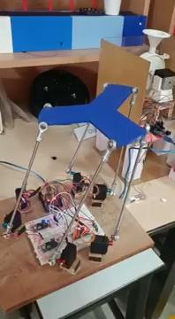
Phase Difference Motion:
Video:

Slide 21
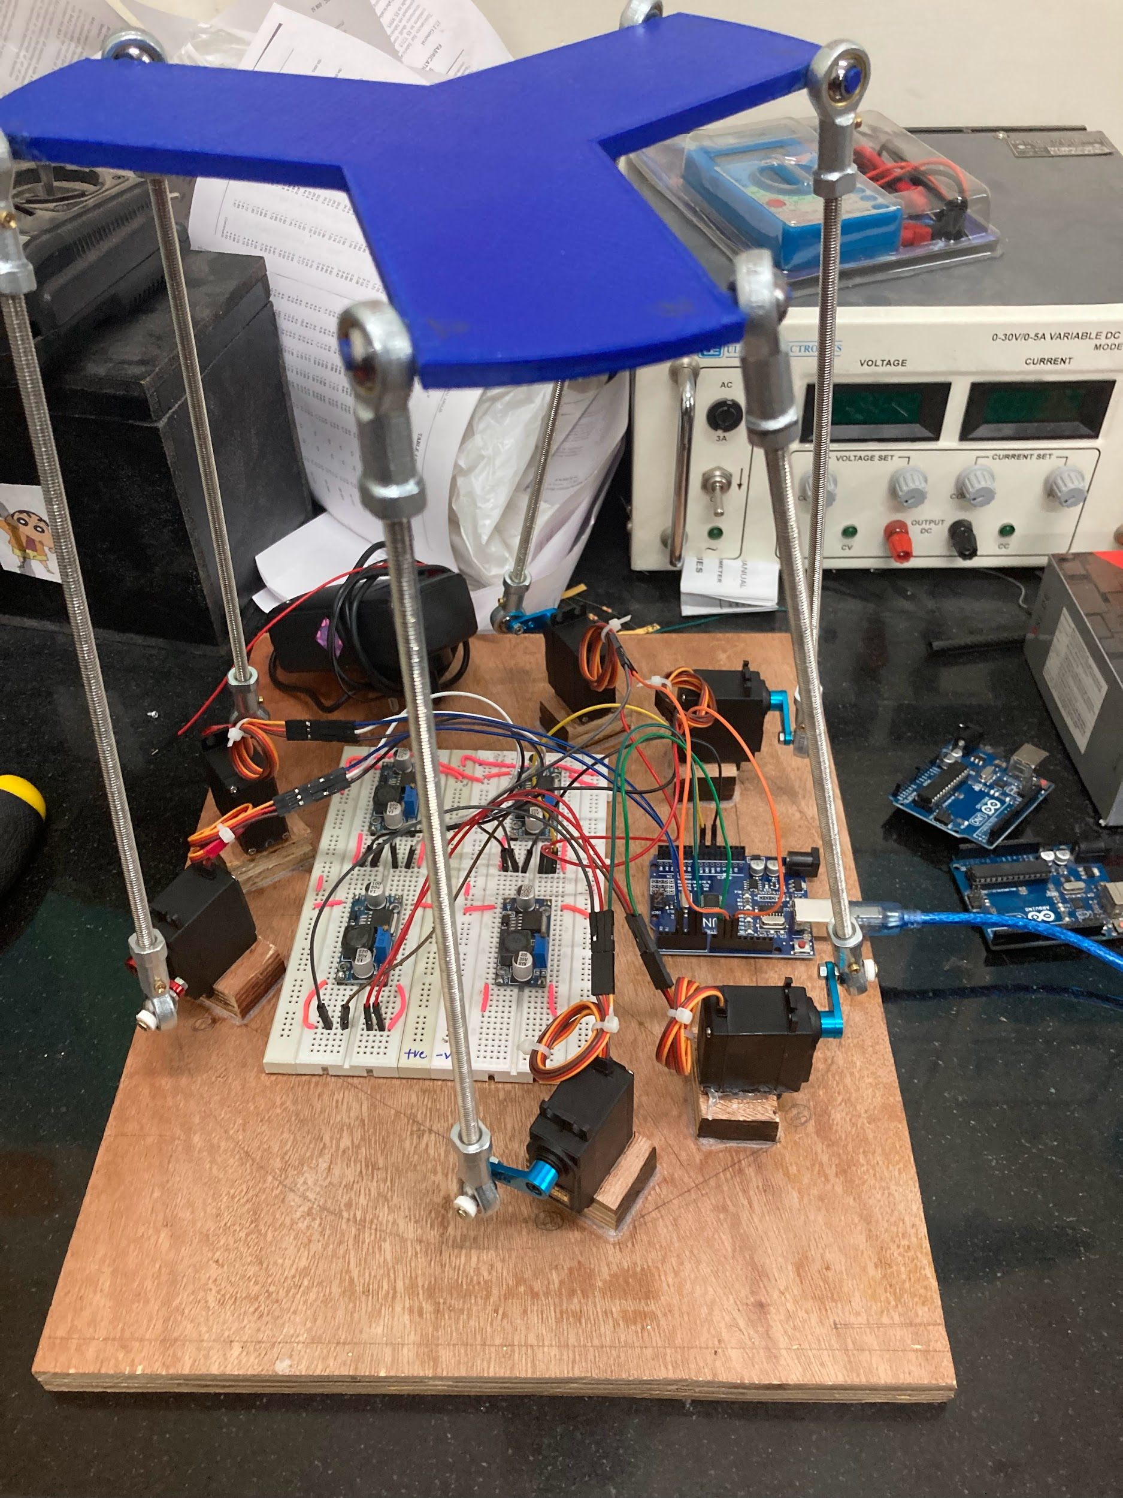
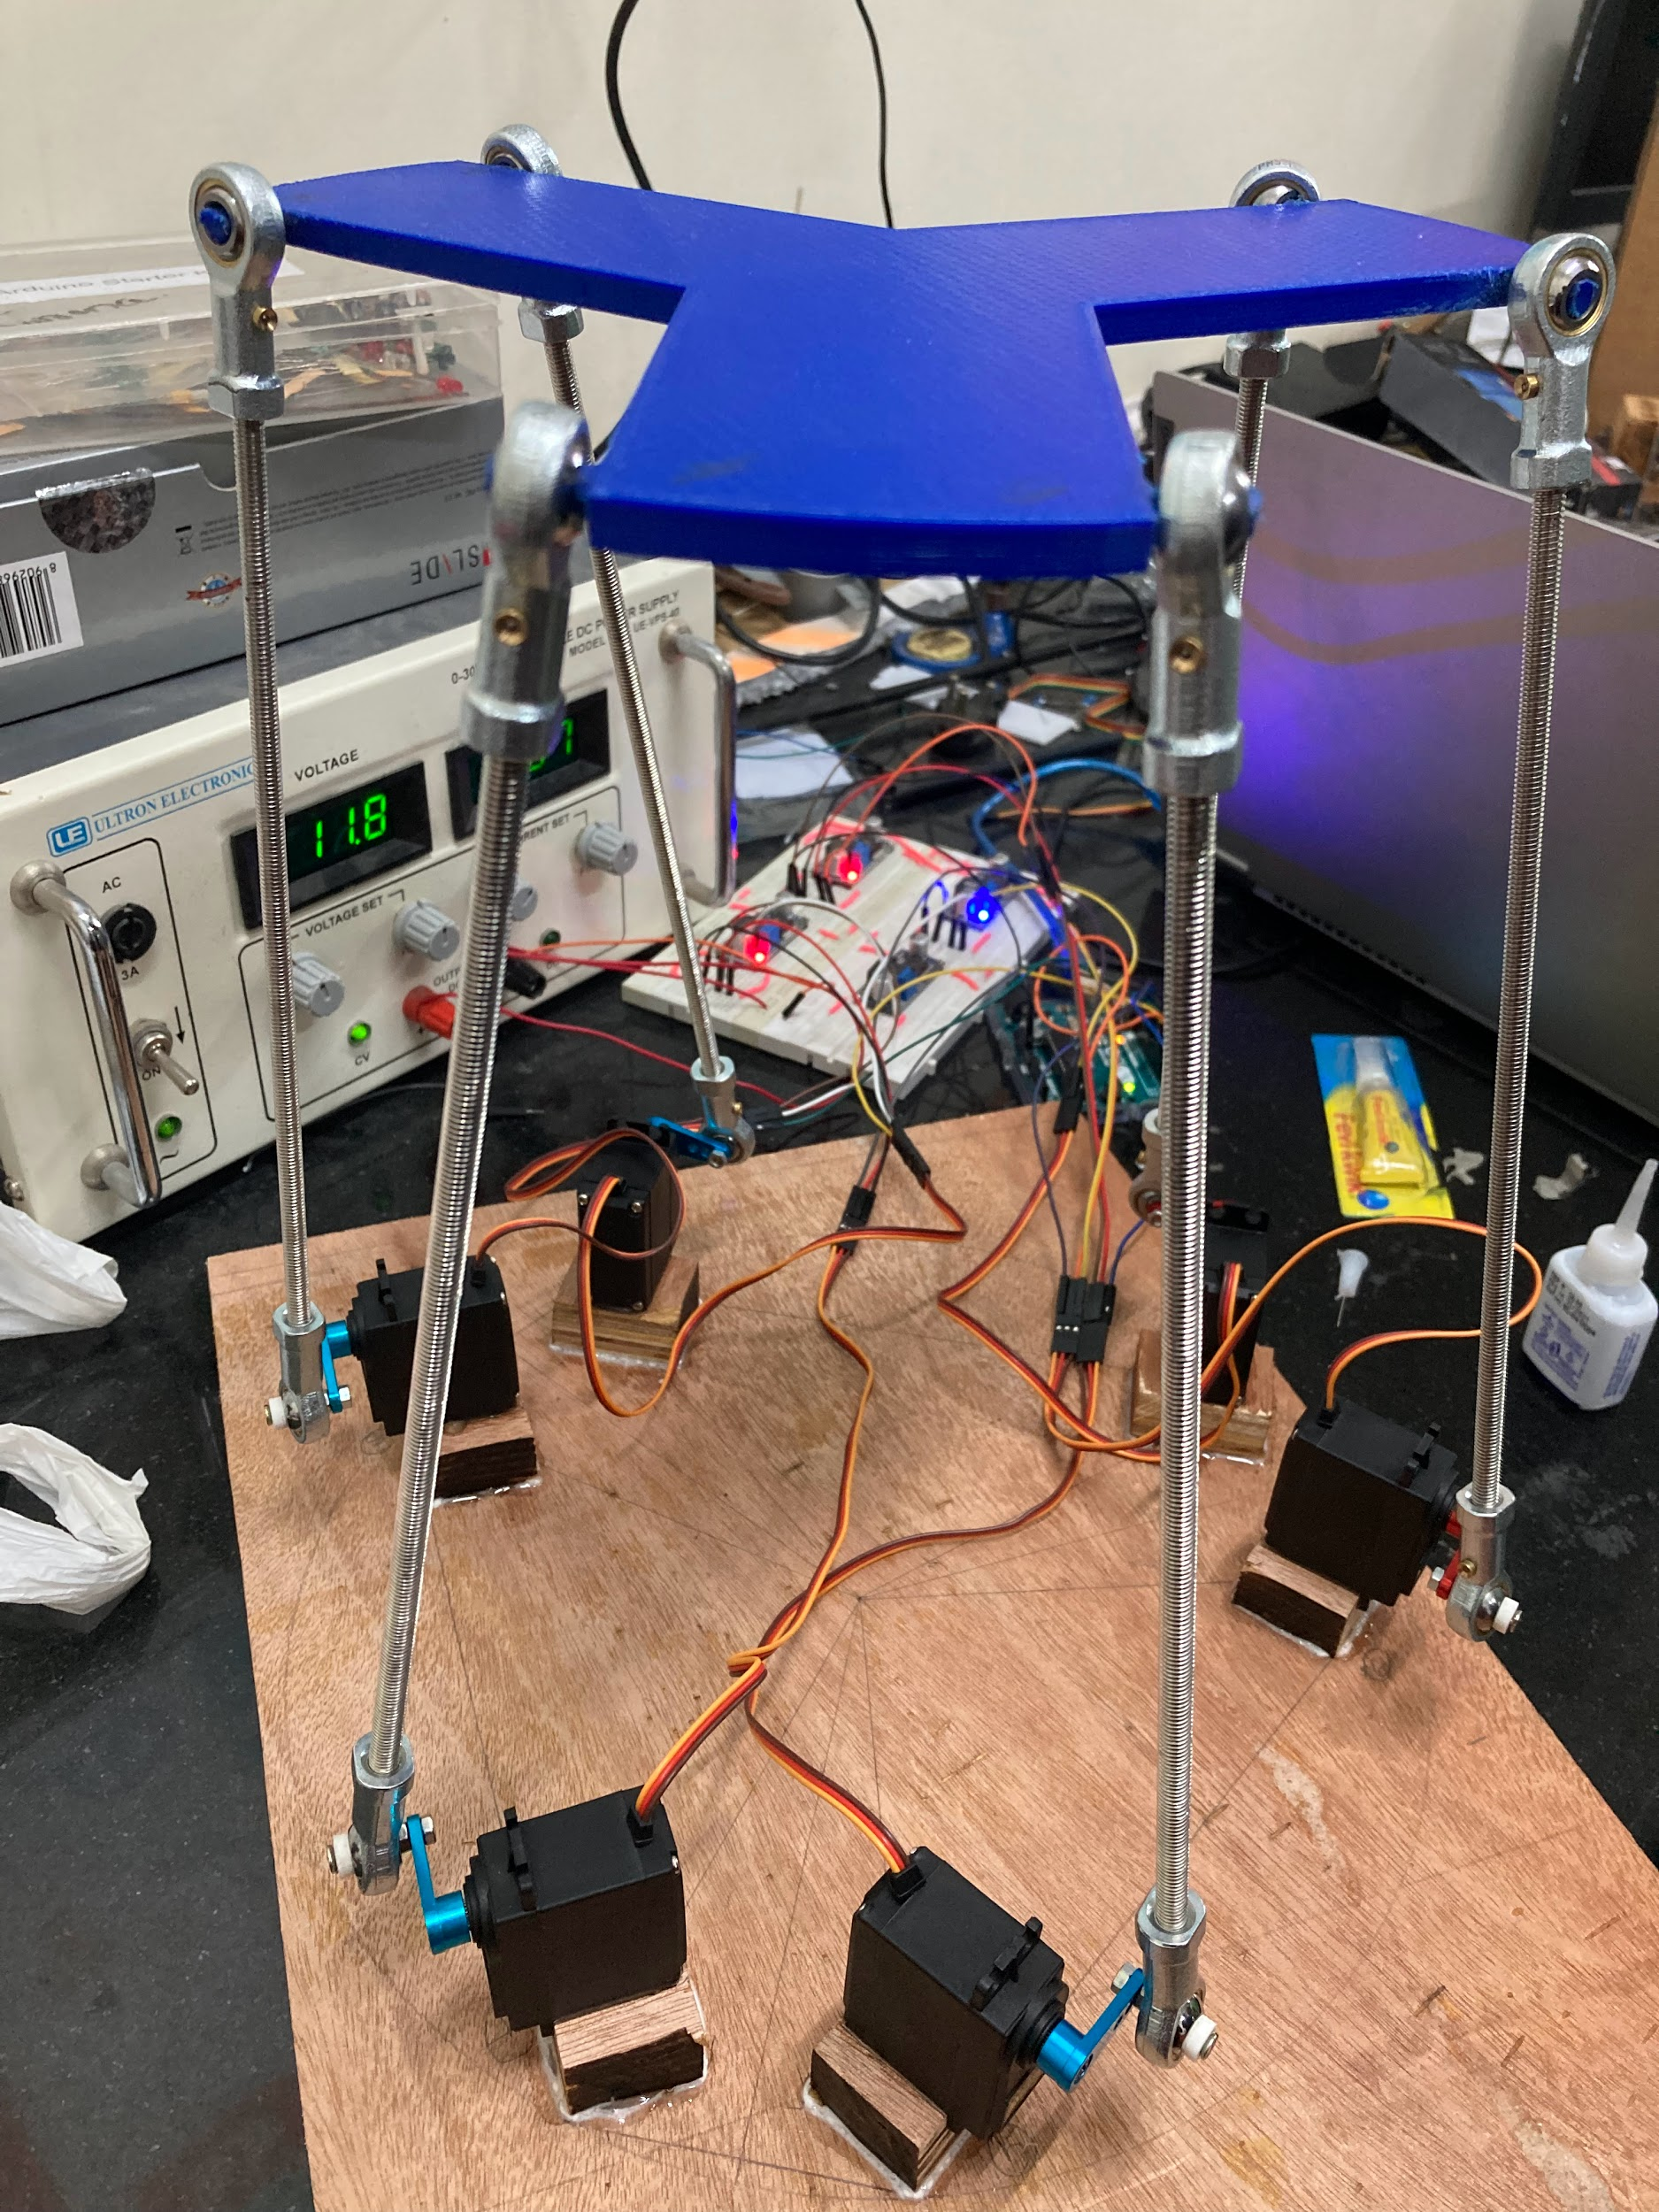
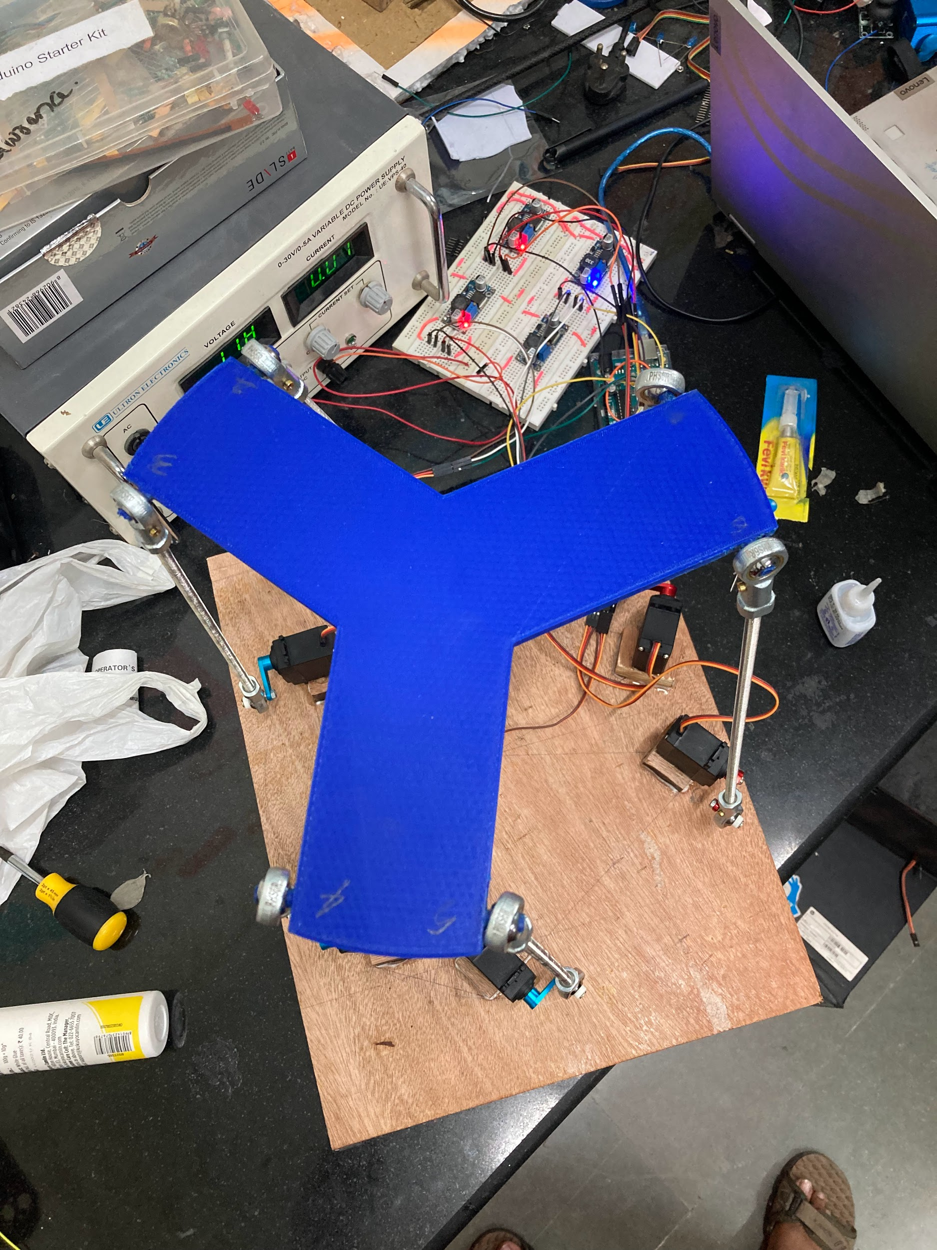
Images of the setup

Slide 22
THANK YOU

